Slide 2
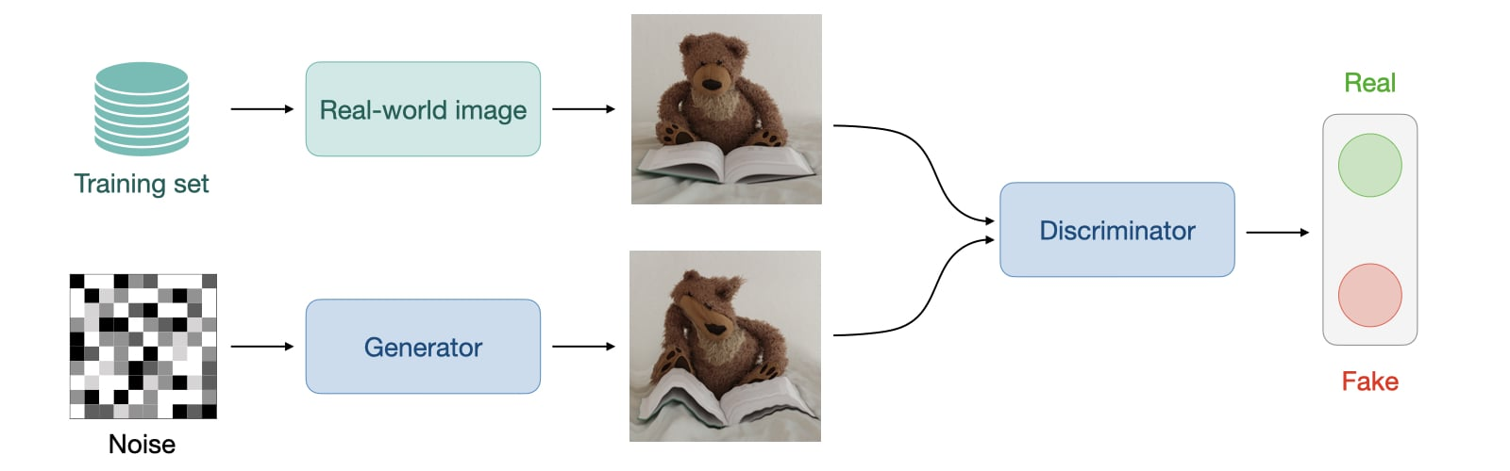
Generative Adversial Networks (GAN)
Like VAE a Generative Adversial Network is a generative learning approach, hence you try to model a distribution (instead of a probability) as close as possible to your data to sample from it. Training a GAN is completly different from what we have seen so far.

Slide 3
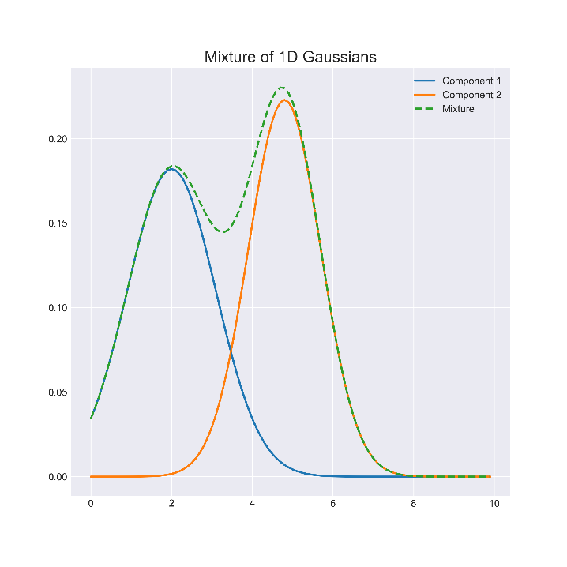
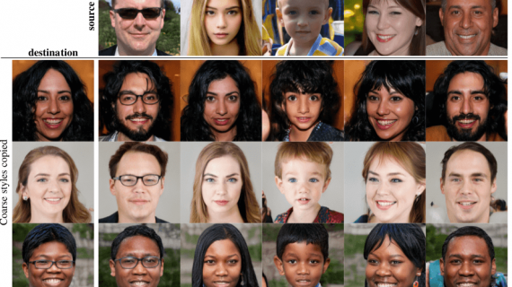
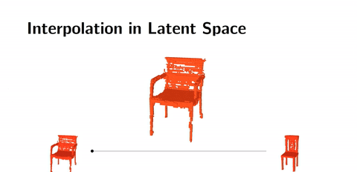
Generative Adversial Networks (GAN)
Since GAN models a distribution, we can use this to do latent space arithmetics (similar of adding gausian distributions) and sample from this new continuous space, with some funny results.

Slide 4

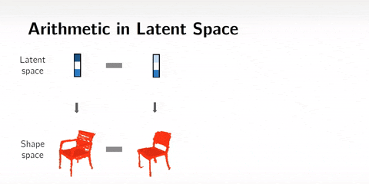
Generative Adversial Networks (GAN)
We can also do style transfer!
Style transfer with Ron Swanson (Deepfakes)

Slide 5
12. Exercise Let‘s train our first GAN!

Slide 6
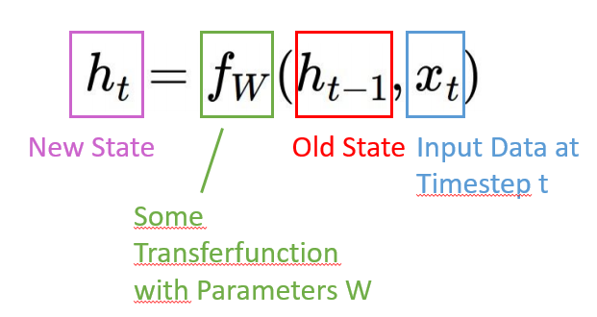
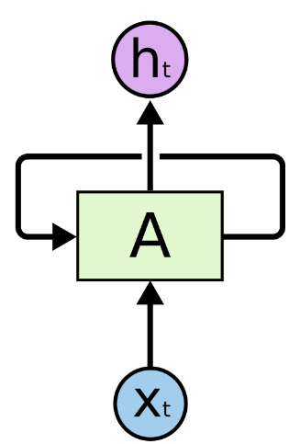
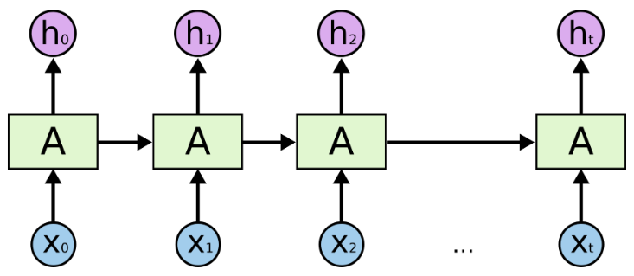
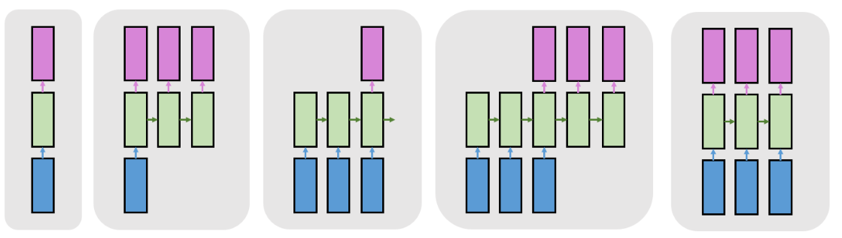
Recurrent Neural Networks
Humans don’t start their thinking from scratch every second. As you read this text, you understand each word based on your understanding of previous words. You don’t throw everything away and start thinking from scratch again. Your thoughts have persistence.
Many to many (without delay)
Many to one
One to one
One to many
Many to many (with delay)

Slide 7
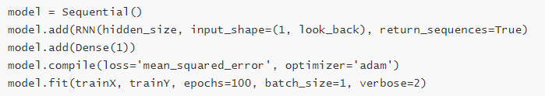

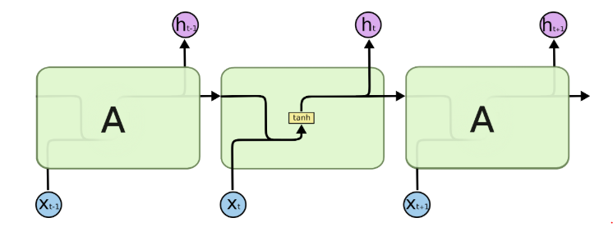
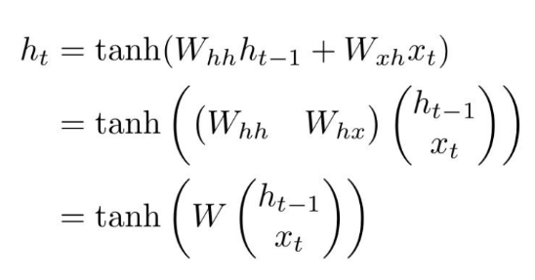
Recurrent Neural Networks

Slide 8
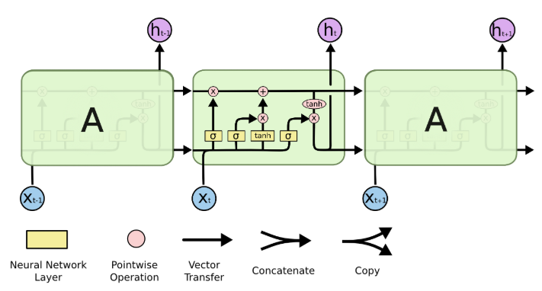
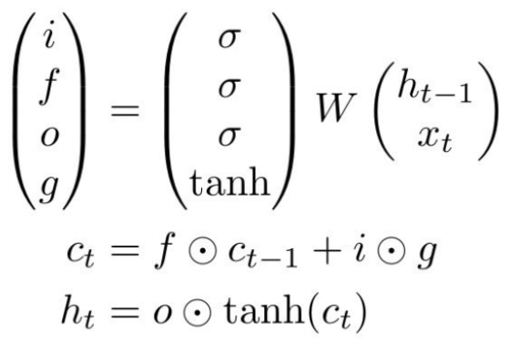
LSTM
LSTM introduces a „gating“ structure that implements a gradient highway (like Resnet) to make them resillient to vanishing gradient

Slide 9

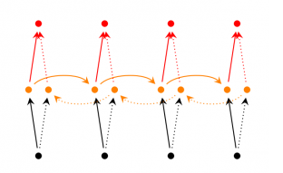
BidirectionalRNN/Sequence to Sequence Models
Bidirectional RNN
Translation models are natural sequence to sequence use cases!
Bidirectional RNN are two seperate RNN receiving reversed outputs, but their output is added together in the end.

Slide 10
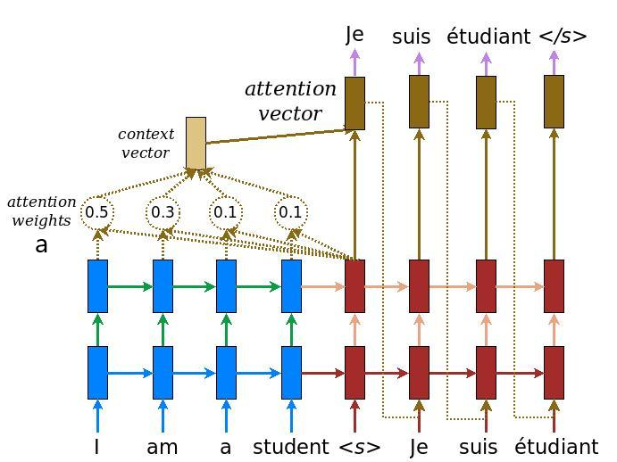
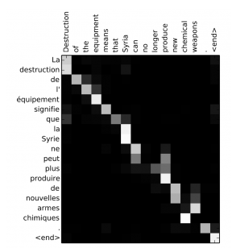
Attention
Attention is a layer on top of an RNN that detemines the importance of each input to the output of the network.
With attention it is possible to plot the cross dependencies of specific words of an input.

Slide 11

Transformer Attention is all you need
Transformers are state of the art models for many translation tasks!

Slide 12
13. Exercise Let‘s train our first RNN on IMDB!

